Slide 1
Engineering design 2025
Lecture Week 2
Deck 3
Context, Missions,
States and Modes
Prof Henri Marais
23 Jul 2025

Slide 2
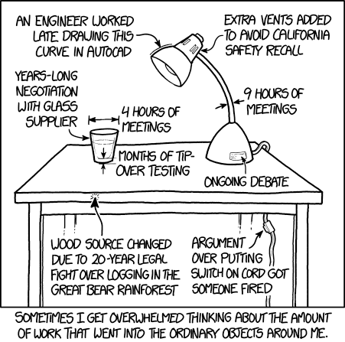
Individual activity
Assuming you are a kettle designer describe the environment in which the kettle functions (10 min)
Swap with another student
Considering your ‘new’ kettle environment are there any ‘missing’ aspects? Is the description clear, unambiguous, easy to interpret?

Slide 3
System context diagrams
How to capture the eco system in which your system functions

Slide 4
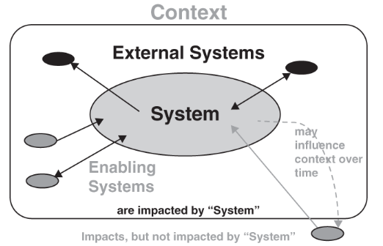
Any system ‘lives’ in a specific context
Notes:
It should be obvious that neither analytic thinking nor synthetic thinking alone would be sufficient to design truly well functioning systems. The synthetic side would gloss over some of the (maybe very important) low-level detail whilst the analytic approach might fail to consider the environment in which the system should operate.
Consider the following: If you were to design a 5V power supply which type of thinking would you naturally lean towards? Most likely analytical thinking and that would quickly lead to some process or procedure that you learned in electronics... That might be perfectly fine for a lab practical but how would the design need to change if
The power supply was to be used in very cold climates such as the arctic?
Very hot climates were more realistic, say for instance the Namib dessert?
What if it were to be used in life saving medical devices?
As you can see the context in which a system is used, is just as important than the technical implementation details.

Slide 5
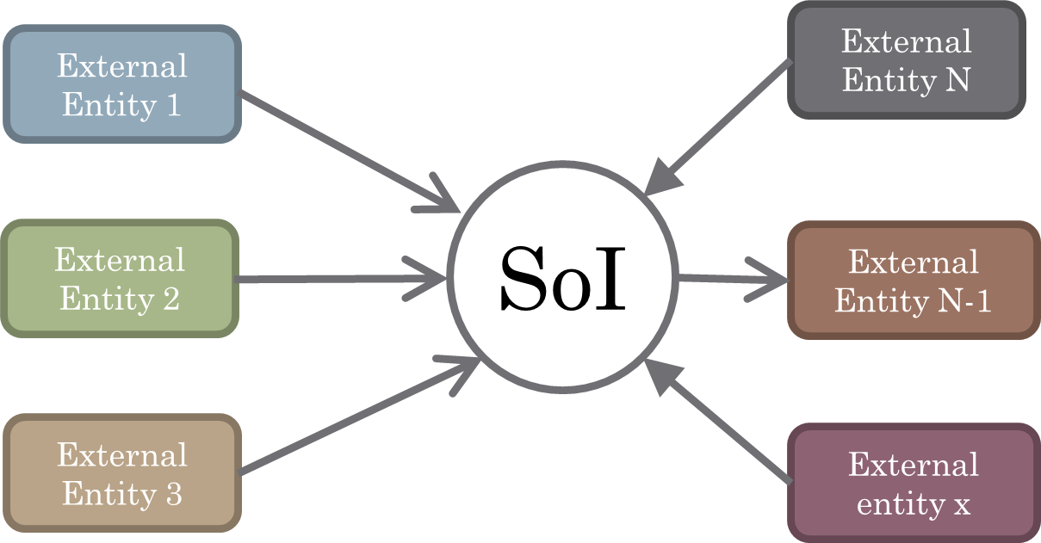
Towards a tool…
System Context Diagram (SCD)
Shows interactions between SoI (system of interest) and containing environment
SoI is seen as a black box
Aim is to establish boundary
Notes:
Systems thinking requires that we think of the system in context
Systems engineering requires analysis of requirements
Requirements stem from interactions with the environment

Slide 6

Why draw Context Diagrams
Simple high-level picture
Identify elements that interact
Define external interfaces
Share common understanding
MOST ISSUES OCCUR HERE!
A Context Diagram is only a snapshot in time.
Start with the operational context (installed and working)
Add additional contexts as (if at all) required
Notes:
Technically there is a context during storage, transport, installation, commissioning, operation, maintenance, and decommissioning.

Slide 7
Context Diagrams
FLOW NAME
Describe item / information flow
TERMINATOR NAME
Can be a function or a thing
FLOW B_NAME
FLOW A_NAME
Terminator
SoI
Terminator
Rules for SCD generation
FLOW C_NAME
SYSTEM OF INTEREST
Include system name and optionally context
(operational / maintenance)
Context Diagram
1x System of Interest (SoI)
1 or many Terminators
1 or many flows between SoI and terminator
Labelled flows

Slide 8
Elements in the SoI environment
Inputs and Outputs
Support Systems
SoI
System Operators
Physical support elements
Operational Maintenance
Physical Environment
Notes:
Inputs and Outputs - primary purpose of most systems is to operate on external stimuli and/or materials in such a manner as to process these inputs in a useful way
System Operators - interface between the operator and the system is one of the most critical of all because of the intimate relationship between the control exercised by the operator and the performance of the system
Operational Maintenance - the manner in which it is to be maintained requires that the system be designed to provide access for monitoring, testing, and repair
Physical Environment - imposes special conditions for which the system must be designed typically extremes of temperature, vibration, humidity etc.
System Housing - stationary systems are installed in an operating site, but mobile systems’ housings on enclosures must provide protection for the system from the elements
Support Systems - part of the infrastructure on which the system depends for carrying out its mission

Slide 9
Interactions and Interfaces
Interaction
Inputs and Outputs
Support Systems
SoI
System Operators
System Housing
External Interface
Operational Maintenance
Physical Environment
Notes:
All interactions take place across interfaces
Interfaces to external elements are called external interfaces
Interfaces internal to the system are called internal interfaces
BOTH internal and external interfaces are the responsibility of the Systems Engineer as these fall beyond the scope of the detail engineer

Slide 10
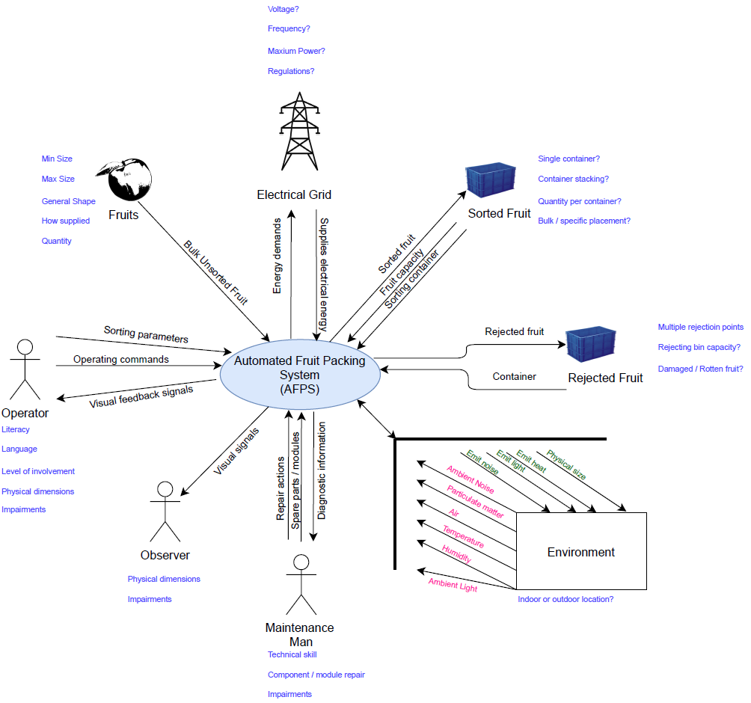
Example SCD of an automated fruit packing system (afps)

Slide 11
System Context Diagram – Key Take aways
Initial step to determine external interfaces and enabling systems
01
Only interactions between SoI and external elements documented
02
Can use icons to aid in understanding
03
Don’t include aspects internal to the SoI in the SCD
04

Slide 12
System missions
A way to describe the system behaviour over time

Slide 13
Missions
Systems have missions. These missions might be long and complicated or rather short and simplistic. At the extreme a system might only have to perform a single task.
Notes:
Consider the example of an aircraft (passenger or otherwise), the core objective is to transport people / goods from point A and B. One such trip is what we refer to as a mission. In this image it is clear that in order to accomplish the mission there are several distinct actions or phases that are required. Some phases might even be duplicated (Taxi in this case). Note that the mission gives us some idea of sequence. A mission diagram requires some consideration as the axis labels are not necessarily obvious.

Slide 14

Missions – An example
Consider this electric weed eater as an example. It is a pretty
simple device that spins plastic line with an electric motor to
chop down weeds and overgrowing grass.
The developers of this product had a certain concept of operation
in mind that drove their design decisions. A mission is one tool
that we can use to accomplish this

Slide 15
Missions – An example
MOTOR
SPEED
MISSION
MOTOR
SPEED
MISSION
Notes:
Two example mission profiles (the graphical depiction of a mission) is provided here. The top one has some variation in how long the motor is kept at speed, and the bottom one has constant “revving” of the machine. Both of these mission profiles could be correct. But this gives us a certain idea of how the system is intended to be used. In both cases the total mission would be to trim the weeds. However, the eventual demands placed on the design is significantly different.

Slide 16

Bread Toasting System (BTS)
If you’ve ever used one of these to toast a large amount of bread in quick succession you would have noticed that the quality deteriorated over time.
Does this mean that the toaster is broken or of poor quality?
Design Intention
Toasting
Temperature
MISSION
Toasting
Temperature
MISSION
User Operating Profile
Notes:
Most domestic kitchen appliances are designed with a mission profile that somewhat resembles the blue profile. Note that a single mission (for this fictitious toaster) assumes that there would be certain “dead-time” between successive missions. If you make use of the toaster according to the red profile however the system is operated outside of the intended envelope.
This is one of the key reasons for constructing a mission profile. It is a diagram that can quickly communicate how you as SE intends for the system to function. If you were to envisage a commercial toaster (which churns out slide after slice without a deterioration in quality) the red profile would be much more accurate than the blue profile.
Mission profiles are context dependent, and no formal graphical representation is provided. You as the SE should decide
IF a mission profile is required for your system. If not, why not?
What the axis labels should be.

Slide 17
Mission diagrams
Not commonly used for simplistic systems
Possibly valuable to communicate temporal behaviour

Slide 18
A high level of behavioural abstraction
States and modes

Slide 19
Describing high-level behaviour
A system has various phases
Deployment
Operation / Maintenance / Sustainment
Retirement / Disposal
System behavior will be different in each phase
System moves between phases
Based on deadlines / time periods
Based on external inputs / triggers / events
Notes:
How do we describe the high-level behaviour of a system. Consider the diagram, in the OM&S (operation, maintenance, and support) block the system performs the required mission / functions / tasks.
However, the system can into being somehow, then got deployed and once the deployment was complete entered either the storage operations phase or the OM&S phase.
All of this requires some form of input / trigger / condition to be true. But more than that we need to be able to describe the system prior to and within each phase.

Slide 20
What is a system state?
A system state is the condition of the system
(PERSONNEL, EQUIPMENT, DATA PROCESS ITEMS, RESOURCES)
that is measurable or observable at a point in time.
Examples:
The copier is in the OPERATIONAL state (thus ready to work)
The rocket is in the LAUNCHING state (starting to take off)
A vehicle is in a DESTROYED state (following a crash)
A rollercoaster system is in the DISMANTLED state (following an event)
Notes:
System states can be thought of as being “observable”. A state is a description of the “being” of a system and is not connected to any specific functionality per se.

Slide 21
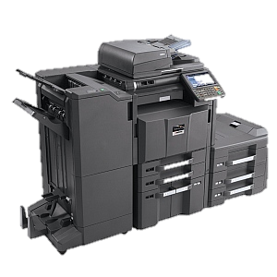
Consider the copier as example
Once deployed it is either:
OPERATE-able
OFF
In STANDBY

Slide 22
Graphic rules for System State Diagrams
A rounded rectangle indicates the state
A solid arrow indicates a required transition
A dotted-line arrow indicates an allowable transition
A strike-through arrow indicates a forbidden transition
Transitions must be labelled (directly or by reference)
A single state is denoted as the initial state / mode by means of a required transition into the state
<
<SOME STATE>

Slide 23
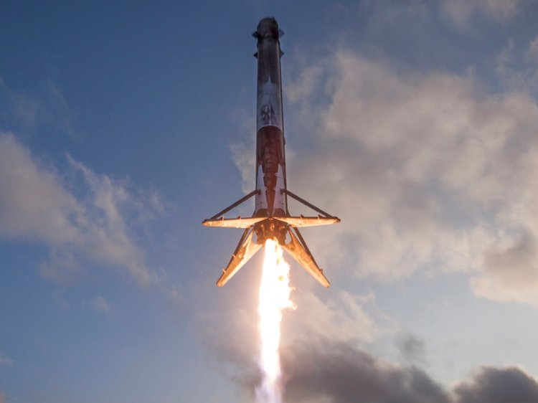
The case of a rocket
Stored
Pre-flight
Aborted
Self-destructed
Launching
Landing
Flying
Crashed
Notes:
Here the transitions were not labelled to draw attention to the fact that it is missing. This example aims to illustrate specifically the use of the various types of transitions.
Notice that we explicitly prohibit transitions that may never occur. In the strictest sense any transition not indicated, although not intended, could be executed in the case of a malfunction.
Prohibiting transitions, then, is not so much about stating the obvious as it is about describing in sufficient detail that which must happen and which may never happen.

Slide 24
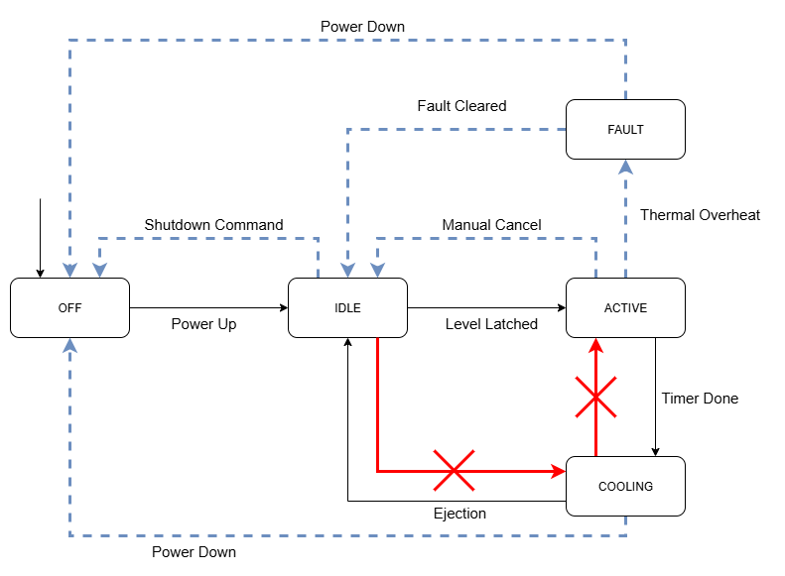
BREAD TOASTING SYSTEM
Notes:
Notice that this diagram provides no temporal information yet already starts to convey how the system is expected to function at a very high level.

Slide 25
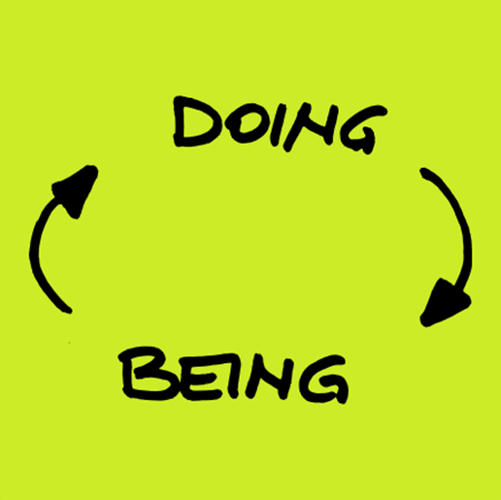
System modes
In some cases, the system is capable of performing discrete functions
Such functions will be dependent on the state of the system
System modes are descriptive of “doing”
The system is “doing this” when in that “state”
Modes are always encapsulated within states
Similar modes may be present in more than one state
Graphically similar to system states
Notes:
System modes, in comparison to system states describe in more detail what the system is supposed to “DO”.
Remember that this is in contrast to a state that simply describes what the system “IS”. In the case of a passenger taxi the system state might be “Operational” but in that state the system modes may be “moving forward”, “decelerating”, “steering”, etc.

Slide 27
System states and modes
System states and modes describe in more detail how the system should function at a high-level
States describe the condition of the system and is observable and or measurable.
Modes are encapsulated within states and describe the functions of the system.
Both system state and system mode diagrams describe the transitions between states and modes.

Slide 28
Wrapping up
States capture macro behaviour of the system
01
Modes refines this behaviour
02
Both are used to determine system requirements
03

Slide 29

Individual activity
Individually, develop a SCD, SSD, and SMD for the hoisting system.
Upload this to Efundi Friday afternoon (use Friday period for doing the work)
PHOTOGRAPH, PDF, JPG, or PNG files (1 file per diagram)

